Slide 1

Multilevel analysis of individual heterogeneity and discriminatory accuracy (MAIHDA) – using multilevel models to study intersectionality
Andrew Bell,
Sheffield Methods Institute, University of Sheffield
@andrewjdbell
Andrew.j.d.bell@Sheffield.ac.uk
29th March 2023

Slide 2
What we are doing today
Learning about a quantitative approach to studying intersectionality
Outline
  What is intersectionality
  Intro/recap to multilevel modelling
  The MAIHDA model
  Example
  Advantages and Limitations
  Key challenges / considerations
  Possible extensions
  Practical session: intersectionality in subjective health, using European Social Survey

Slide 3
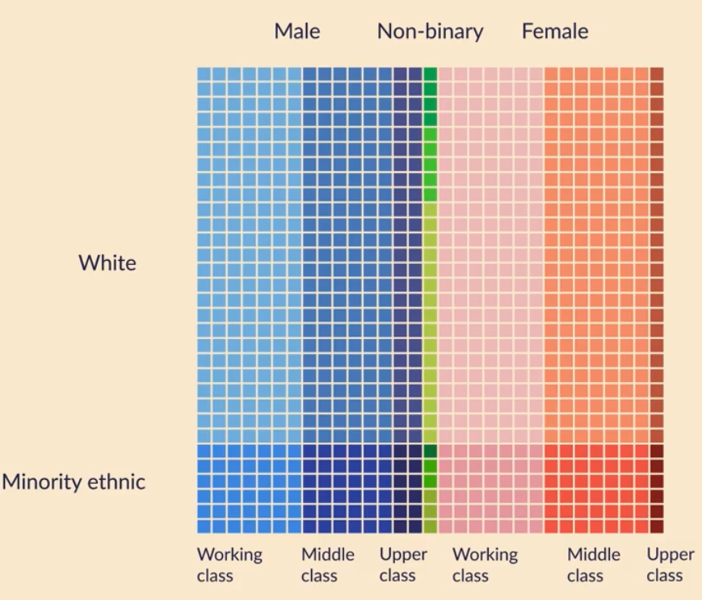
What is intersectionality
Two essential ingredients
  Heterogeneity
    Our identity is more than just the sum of our various characteristics

Slide 4
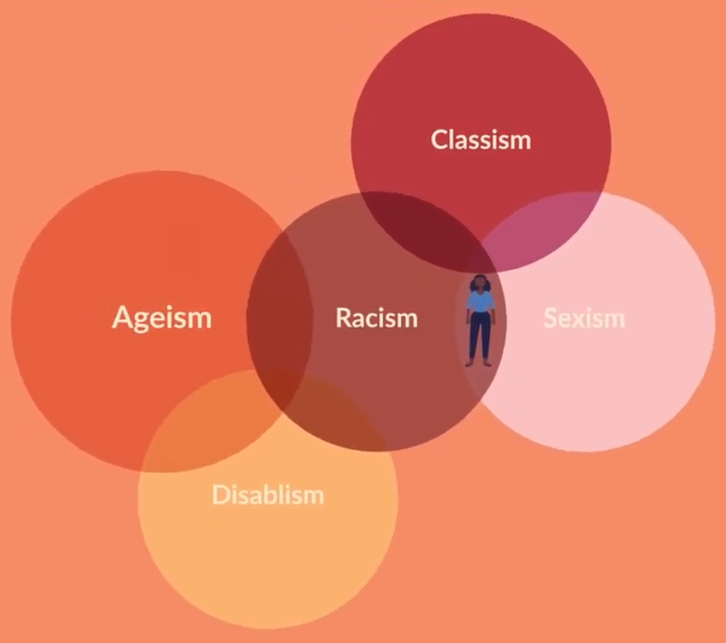
What is intersectionality
Two essential ingredients
  Heterogeneity
  Social Power
    Social processes and hierarchies produce disadvantage in complex ways, meaning multiple disadvantages interact

Slide 5
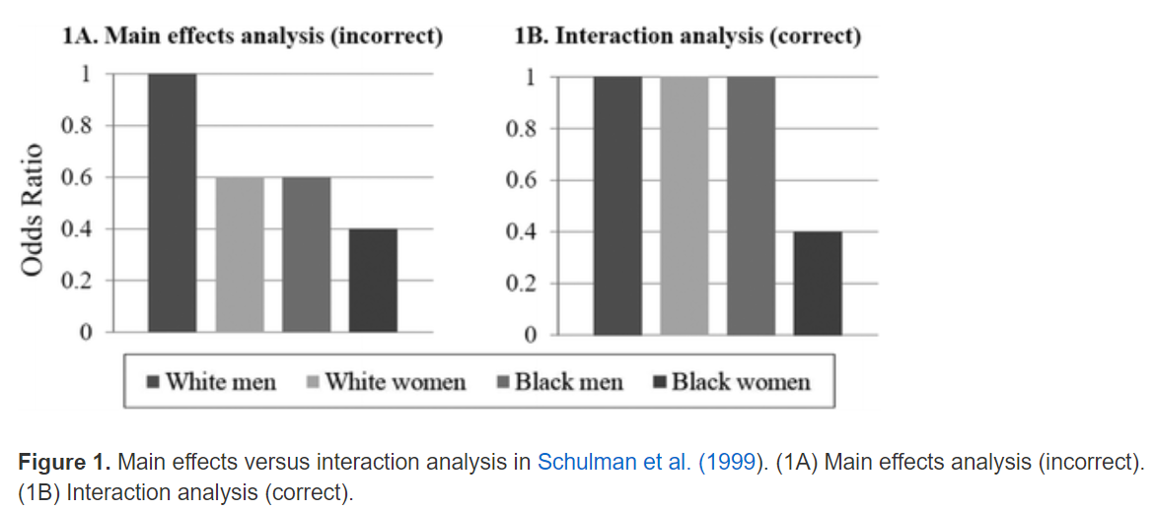
What is intersectionality
Understanding the ways that different dimensions of inequality compound themselves (Kimberley Crenshaw)
Eg Race and Sex

Slide 6
What is intersectionality
Intersectionality often thought of as a concept for qualitative research – but it originated in the quantitative realm (see previous slide)
Today: think about how to use quantitative methods to uncover intersectional differences
But first: a bit of stats class!

Slide 7
Multilevel modelling
Consider a basic regression model
Y
Y = B0 + B1*X + e
e
X

Slide 8
Multilevel modelling
Consider a basic regression model
We assume observations are independent… but we know that this isn’t true!
Y
Y = B0 + B1*X + e
e
X

Slide 9
Multilevel modelling
We often find multilevel structures throughout society
  Students are educated in schools
  People live in neighbourhoods
  Cows live on farms
  Patients are treated in hospitals
“once you know hierarchies exist, you see them everywhere” (Kreft and De Leeuw, 1998 p1)
These hierarchies introduce dependency – and we need a statistical model to deal with that

Slide 10


Multilevel models decompose the residual into two parts – people are “nested” within neighbourhoods
Health
Neighbourhoods
e
People
u
$${Health}_{ij}=β_{0}+β_{1}{Income}_{ij}+(u_{j}+e_{ij})$$
We estimate B0 and B1, but also the variance of u (nhood effects) and e (individual effects)
Income
$$u_{j}\sim N(0, σ_{u}^{2})$$
$$e_{ij}\sim N(0, σ_{e}^{2})$$

Slide 11
Multilevel modelling
What does this do?
  Allows us to see the source of unexplained variance (do nhoods or people matter more?) – Variance Partitioning Coefficient
  Allows us to compare higher level units (which is the healthiest nhood?)
  Allows us to consider both individual and nhood characteristics and what they do (is individual income related to health? Is nhood pollution level related to health?)
In R
Model <- lmer(Health ~ Income + Pollution + (1|Nhood), data=df)

Slide 12
Back to intersectionality
We described how individuals are defined by a complex combination of identities
And difference/inequalities are produced across those complex combinations of identities
How could we model this?
Option 1: main effects in standard model
This will tell us the effects of each separate characteristic, but these are assumed to be the same for everyone. It won’t tell us the combined effect of multiple characteristics
Y = B0 + B1*Male + B2*Non-white + B3*Age …+ e

Slide 13
Back to intersectionality
Option 2: add in some interactions
This model is now very complicated! (eg how to interpret what B5 means)
It’s also very much at risk of multiple testing issues
Y = B0 + B1*Male + B2*Non-white + B3*Age +
B4*Male*Nonwhite + B5*Male*Age + B5*Non-white*Age + B6*Male*Nonwhite*Age + e

Slide 14



Back to intersectionality
Option 3: Think of intersectional strata as a level in a multilevel model
Ie: individuals are nested in their intersectional strata
So:
  1: create our intersectional strata – ie a unique id for each combination of our intersectional identities
  2: use these as our level 2 identifiers in a null/empty model
But at present – are these differences produced by just adding intersectional inequalities together, or through interactions/multiplicative differences?
Intersectional strata
$${\left(1\right)Health}_{ij}=β_{0}+(u_{j}+e_{ij})$$
$$u_{j}\sim N(0, σ_{u}^{2})$$
$$e_{ij}\sim N(0, σ_{e}^{2})$$
Individuals

Slide 15
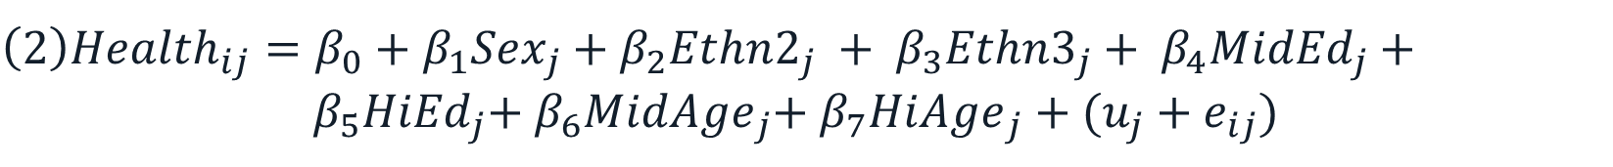



Back to intersectionality
Option 3: Think of intersectional strata as a level in a multilevel model
Ie: individuals are nested in their intersectional strata
We can run two models – one an empty / null model, and one with main effects for our intersectional variables… and see what changes between them
We’d expect the variance of u to reduce – but how much?
Amount of variance remaining = multiplicative.
Intersectional strata
$${\left(1\right)Health}_{ij}=β_{0}+(u_{j}+e_{ij})$$
Individuals
${\left(2\right)Health}_{ij}=β_{0}+β_{1}{Sex}_{j}$ +${ β}_{2}{Ethn2}_{j}$ + ${ β}_{3}{Ethn3}_{j}$ + ${ β}_{4}{MidEd}_{j}$ + ${ β}_{5}{HiEd}_{j}$+${ β}_{6}{MidAge}_{j}$+${ β}_{7}{HiAge}_{j}$ +$(u_{j}+e_{ij})$
$$u_{j}\sim N(0, σ_{u}^{2})$$
$$e_{ij}\sim N(0, σ_{e}^{2})$$

Slide 16
This is MAIHDA
Can answer these sorts of questions
  How much do our intersections matter? Or How big are differences between intersections?
  How much “discriminatory accuracy” – variability within/overlap between intersections
  … Before and after controlling for “main effects” – so are intersectional effects additive only, or also multiplicative?
  Which intersections are the most advantaged/disadvantaged?
In R – just like any other multilevel model (once we’ve created our strata-level variable)
Model1 <- lmer(Health ~ 1 + (1|strata), data=df)
Model2 <- lmer(Health ~ 1 + Sex + Ethnicity + Education + (1|strata), data=df)

Slide 17
Why not just use loads of dummy variables (FE approach)
We could… but turns out this is equivalent to option 2 above!
No “shrinkage” – estimates may be unreliably estimated (particularly for small intersectional strata)
Greater risk of multiple testing (no shrinkage) – Bell et al 2019
Harder to separate additive and multiplicative

Slide 18
Some important limitations
This approach is explicitly exploratory
In that, we aren’t usually testing whether a particular intersectional strata is different from others
Rather – an approach that looks at patterns and draws conclusions from that
But exploration can be robust!

Slide 19
Some important limitations
Sample size considerations
We are dividing up the population into subgroups…
Including into subgroups we know are likely to be relatively small
Even with a large population there may be subgroups with zero people! And others with just a handful of people
That requires some thought
  How many variables should I include to define strata
  How many groups should I divide each variable into
If we can’t divide our variables enough, is it better to do something more standard / non-intersectional?
  That will depend on
    the research question being asked (eg are you interested in particular intersectional groups?)
    the nature of the variables defining intersection
    THEORY THEORY THEORY (i.e. what does theory say will be important / less important
    how big a dataset do you have
  Eg: Ethnicity as “White vs Non-White”

Slide 20
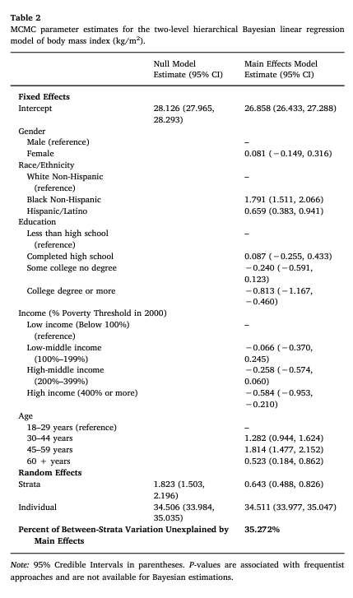
Examples
Evans et al 2018
Outcome variable: BMI (obesity)
Variables defining strata:
  Gender (2 categories)
  Ethnicity (3 categories)
  Income (4 categories)
  Education (4 categories)
  Age (4 categories)
Potentially 2*3*4*4*4 = 385 strata (but some might be empty)

Slide 21
Examples
Evans et al 2018
How multiplicative are the effects of these variables?
  See how strata-level variance reduces when main effects are controlled for
  Answer: about 35% multiplicative (so 65% additive)

Slide 22
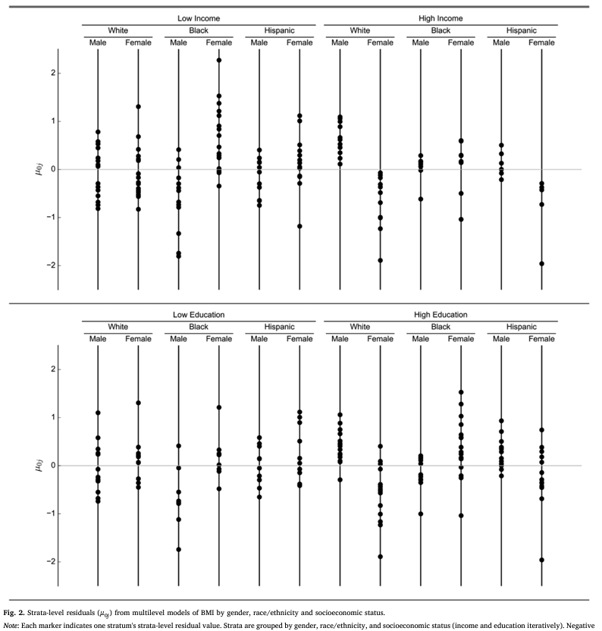
Examples
Evans et al 2018
Plotting individual residuals – tricky when there are so many of them!
Here – plotted by “supercategories”
But require decisions to be made about what you show – that is: which variables to divide things by

Slide 23
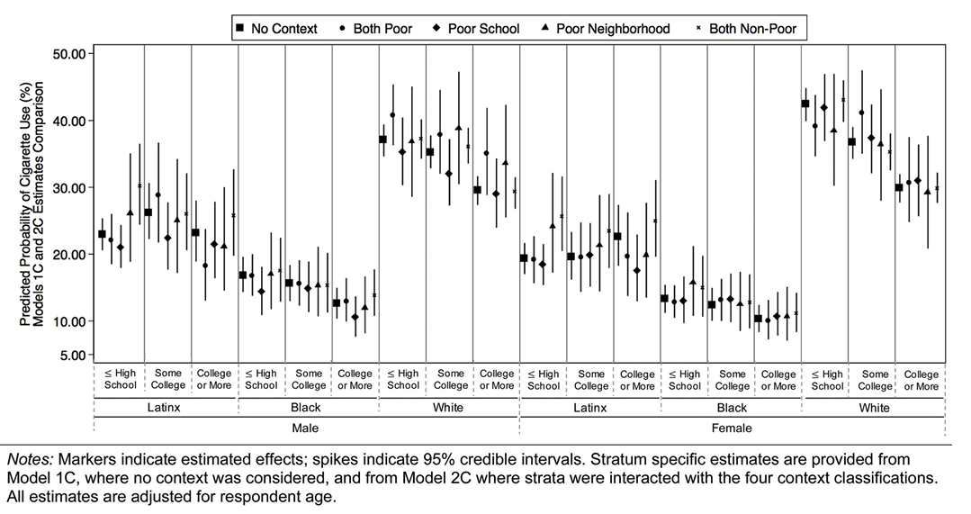
Examples
Other examples (Evans 2019) – but again, requires decisions about how to group…
Important: consider whether you want to report the residuals from model 1 or model 2
  Model 1 residuals: these are full predictions (alternatively, make predictions from model 2 that include both fixed and random part)
  Model 2 residuals: These are the multiplicative part only, and are more tricky to interpret than the full predictions – ie they are the differentials from the main effects (eg: is a strata more disadvantaged than we’d expect given the combination of additive disadvantages that they have)

Slide 24
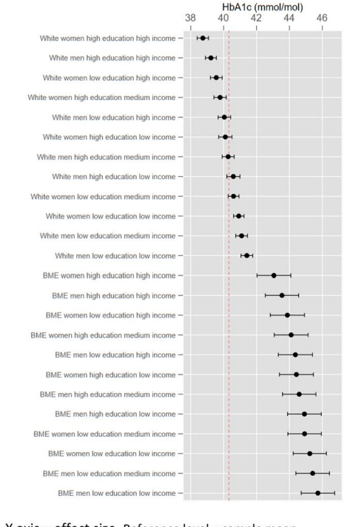
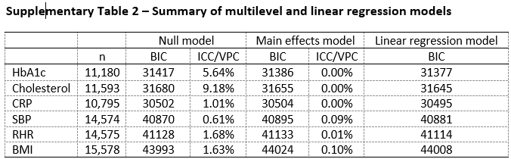
Examples
Holman et al (2019) – these are actually predictions from a standard regression model (the comparison of model 1 and model 2 showed no multiplicative effects)

Slide 25
Key conceptual challenges
What do we mean by intersectionality?
  Is it being driven by societal power structures of oppression?
  Does it have to be multiplicative to be intersectional?
  With so many results, how do we focus on results / tell a story without bias?

Slide 26
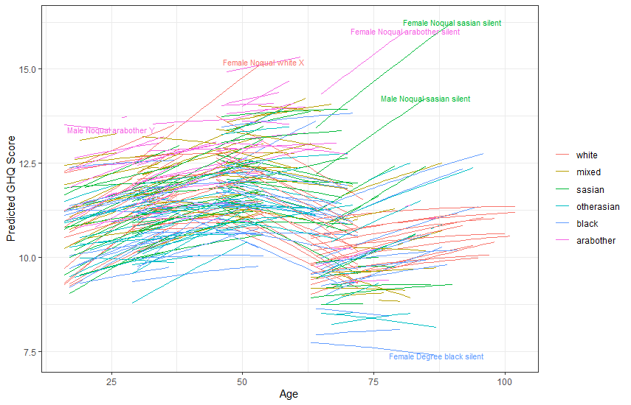
Where to go next with these models
Multilevel models are highly flexible, and MAIHDA models are no exception
Longitudinal analysis (paper in progress)
Non-changing strata
Individuals
Occasions

Slide 27
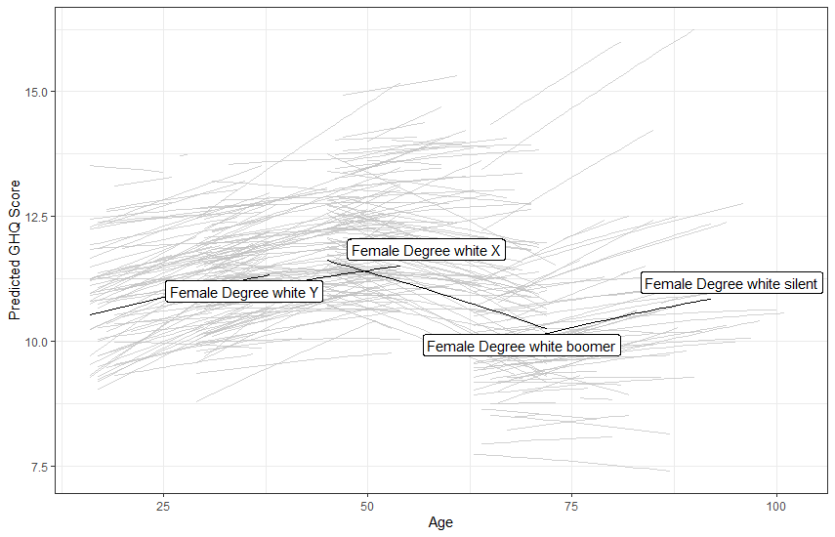
Where to go next with these models
Multilevel models are highly flexible, and MAIHDA models are no exception
Longitudinal analysis (paper in progress)
Non-changing strata
Individuals
Occasions

Slide 28
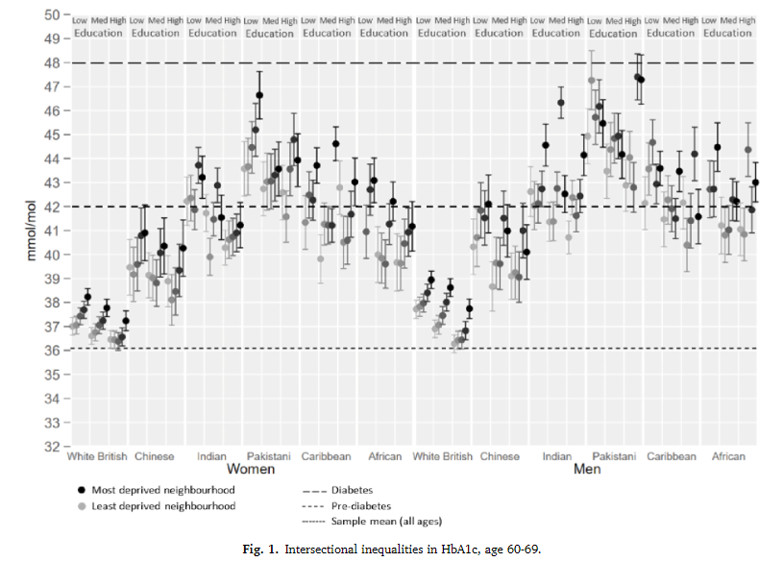
Where to go next with these models
Multilevel models are highly flexible, and MAIHDA models are no exception
Longitudinal analysis
Geographical Analysis (Holman et al 2022)
Intersections
Neighbourhood
People

Slide 29
Where to go next with these models
Multilevel models are highly flexible, and MAIHDA models are no exception
Longitudinal analysis
Geographical Analysis (Holman et al 2022)
Non-continuous-Y variables?
Policy evaluation?

Slide 30
Lots relating to these models happening at Sheffield
Topic areas include the effect of unpaid care, effects of alcohol policy, etc
  All things that could be unevenly and intersectionally distributed
Various grants in the pipeline to work on these issues more
If you are doing work using these methods we’d (Dan and I) be really interested to hear about it
Andrew.j.d.bell@sheffield.ac.uk
@andrewjdbell

Slide 31
Any questions?

Slide 32
Any questions?
Now: 10 min break, then we’ll do the practical exercise.
Get in touch:
Andrew.j.d.bell@sheffield.ac.uk
@andrewjdbell

Slide 33
References
Evans et al 2018 - https://www.sciencedirect.com/science/article/pii/S0277953617306664
Evans 2019 - https://www.sciencedirect.com/science/article/pii/S1353829219306707
Bell 2019 (shrinkage) - https://econtent.hogrefe.com/doi/10.1027/1614-2241/a000167
Holman 2020 https://www.nature.com/articles/s41598-020-69934-8
Holman 2022 (geography) https://www.sciencedirect.com/science/article/pii/S1353829222001320
Intersectionality and Health video: https://www.youtube.com/watch?v=rwqnC1fy_zc
Dan’s project website: https://intersectionalhealth.org/

